Slide 1
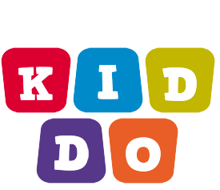
Kids Learning Application
.

Slide 2
INTRODUCTION TO KIDDO
Children are in the midst of a vast, unplanned experiment, surrounded by digital technologies that were not available but 5 years ago.
As many of the self-proclaimed educational apps are very entertainment-oriented due to several reasons they lack an educational impact on child cognitive development.
Kiddo is really an interesting application for kids to learn at early stage of their life.

Slide 3
OBJECTIVE
Educational applications “KIDDO” can help children to learn about letters, numbers, and names of animals and to perform simple calculations.
The educational application “KIDDO” can help children learn to spell letters and words.
The educational application KIDDO” becomes an alternative learning tool for children.

Slide 4
Growth of mobile application in recent years..

Slide 5
METHADOLOGY.
Coding & Testing
Code your application and run test cases.
Design and Structure
Start with planning your application.
Start & Planning
Design your application according to your desire.

Slide 6
Data flow diagram.
.
Video
Learning
Audio
Learning
Shapes
Learning
Look & Choose
Alphabet Learning Learni g
Listen & Guess

Slide 7
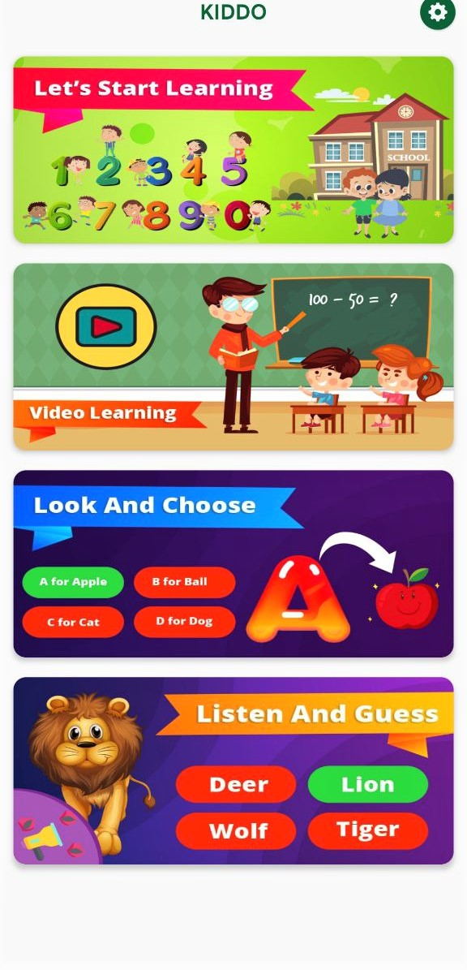
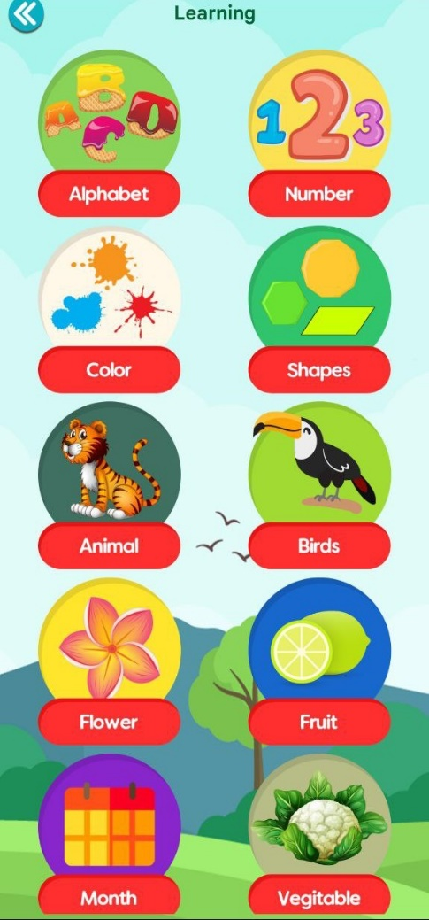
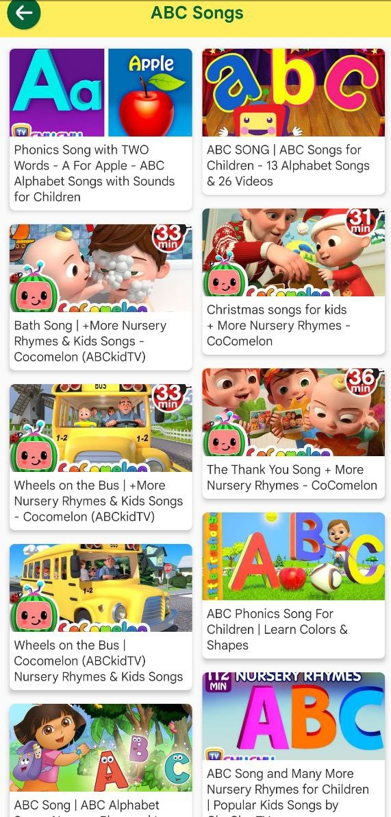
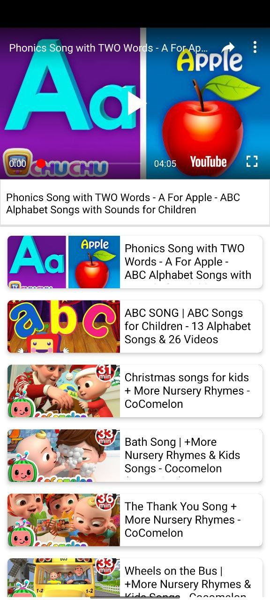
Design and implementation.
Screenshot of kiddo
Screenshot of kiddo

Slide 8
Tools and Technology used

Slide 9
1. JAVA
Java is a high-level, class-based, object-oriented programming language that is designed to have as few implementation dependencies as possible. It is a general-purpose programming language intended to let programmers write once, run anywhere (WORA), meaning that compiled Java code can run on all platforms that support Java without the need to recompile. Java applications are typically compiled to that can run on any Java virtual machine (JVM) regardless of the underlying computer architecture. The syntax of Java is similar to C and C++, but has fewer low-level facilities than either of them. The Java runtime provides dynamic capabilities (such as reflection and runtime code modification) that are typically not available in traditional compiled languages. As of 2019, Java was one of the most popular programming languages in use according to github, particularly for client–server web applications, with a reported 9 million developers

Slide 10
2 ANDROID STUDIO.
Android Studio is the official integrated development environment (IDE) for Google's Android operating system, built on IDEA software and designed specifically for Android development.It is available for download on Windows, macOs and Linux based operating systems or as a subscription-based service in 2020. It is a replacement for the Eclipse Android Development Tools (E-ADT) as the primary IDE for native Android application development.
Android Studio was announced on May 16, 2013, at the Google I/O conference. It was in early access preview stage starting from version 0.1 in May 2013, then entered beta stage starting from version 0.8 which was released in June 2014. The first stable build was released in December 2014, starting from version 1.0
On May 7, 2019, Kotlin replaced Java as Google's preferred language for Android app development. Java is still supported, as is C++

Slide 11
3. ANDROID SDK AND TOOLS.
The Android SDK is a software development kit that includes a comprehensive set of development tools. These include a debugger, libraries, a handset emulator based on QEMU, documentation, sample code, and tutorials. Currently supported development platforms include computers running Linux (any modern desktop Linux distribution), Mac OS X 10.5.8 or later, and Windows 7 or later. As of March 2015, the SDK is not available on Android itself, but software development is possible by using specialized Android applications.
Until around the end of 2014, the officially-supported integrated development environment (IDE) was Eclipse using the Android Development Tools (ADT) Plugin. As of 2015, Android Studio, is the official IDE; however, developers are free to use others, but Google made it clear that ADT was officially deprecated since the end of 2015 to focus on Android Studio as the official Android IDE. Additionally, developers may use any text editor to edit Java and XML files, then use command.

Slide 12
RESULT
Mobile applications (apps) At the apex of the boom of smart mobile devices is the introduction of applications (apps) for tablets and smartphones. Various researchers mention that besides the technological features of the smart mobile devices, these are in favour of young children mostly due to the existence of mobile applications specially Mobile educational applications for children 261 designed for these devices. Research has revealed that young children are very engaged with the apps and love to play with them for various amounts of time depending on their needs and interests and the content and structure of the app. A mobile application is a computer program designed to run on mobile devices such as smartphones and tablet computers.Wikipedia. A mobile application may also be known as an app, iPhone app or smartphone app.

Slide 13
CONCLUSION
The 21st century is an age of mobility and ease Young children are being increasingly exposed to media, technology, and screen time at home and in instructional settings. The use of smart mobile devices among primary school children and toddlers is also growing exponentially as children have more access to smartphones through their parents (increasing mobile penetration globally) and 270 S. as schools embrace technology .The ease of use, portability, speed and responsiveness of the smart mobile devices and especially tablets were said to make it an ideal learning tool (Watts et al., 2012). Although some educators argue that they have no place in young children’s lives the majority enthusiastically embrace those new media for learning The reason is that ‘active, appropriate use of technology and media can support and extend traditional materials in valuable ways … both cognitive and social’ (NAEYC, 2012, p.7). The amount of time that children spend with digital media and the surge in educational apps’ popularity suggest that at least some apps are being used in an attempt to supplement learning outside of school

Slide 14
FUTURE WORK.
THE APP MARKET PLACE
Mobile applications have turned into a quick enrichment tool for the software industry. Since its entrance into the iPhone business in 2007 (the first smart mobile device with touchscreen), the mobile app industry business has matured and has become part and parcel of the economy itself This rapidly expanding mobile-app industry is worth billions of dollars (Nielsen, 2012). Apple’s digital app store, called App Store, opened for the first time on 10 July 2008, providing free or paid applications for iPhone, and later for iPod touch and iPad devices. In 2011, more than 2.5 billion dollars were ‘paid’ to the software industry while in 2014 apps generated over 10 billion dollars in revenue for developers (Apple, 2015). As Apple’s CEO stated, at the end of 2014, users had downloaded 75 billion applications and had visited the App Store 300 million times per week (Perez, 2014). Three models, paid, in-app purchase and advertising, power the mobile app business. Total app revenues are projected to grow from 45.37 billion dollars in 2015 to 76.52 billion dollars in 2017

Slide 15

.

